Slide 1
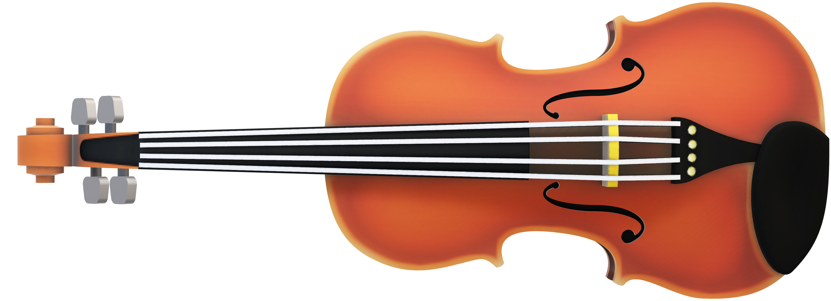
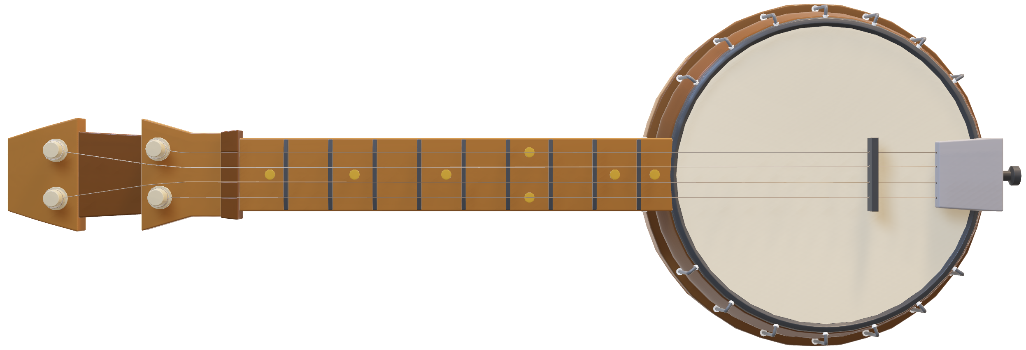
Groove Galaxy
Cherilyn Christen, Rassene M’sadaa, Zeineb Mellouli
Notes:
Cherie

Slide 2

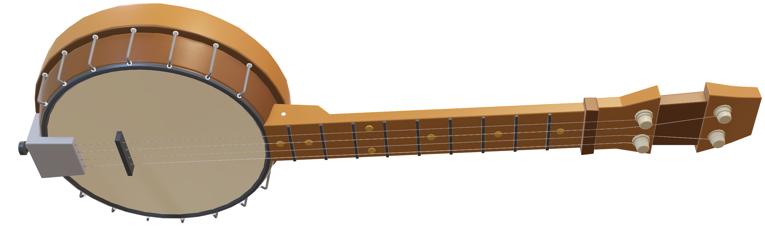
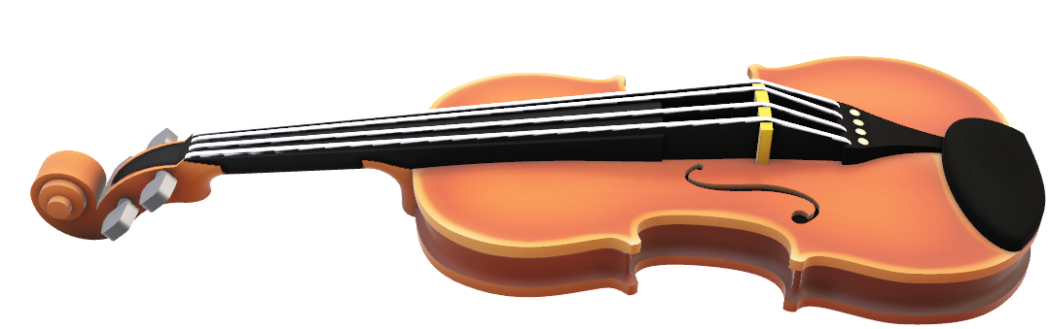
Executive Summary
DMZ
System Architecture
Secure communication
Secure channels and key distribution
Security challenge
Conclusion
Demonstration
Server
Client
Gateway
Intranet
Database
Notes:
Cherie

Slide 3
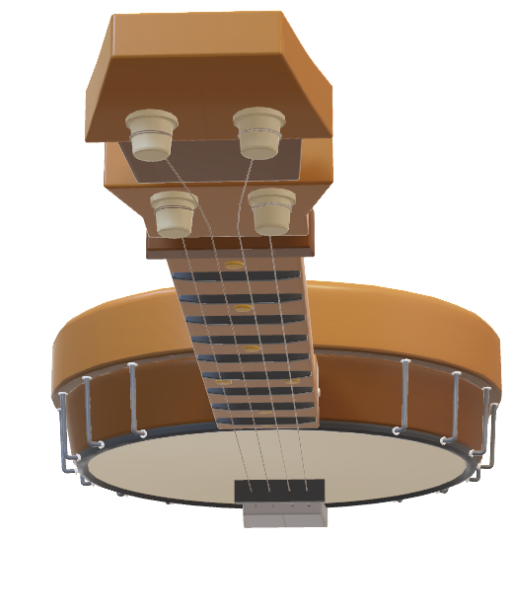
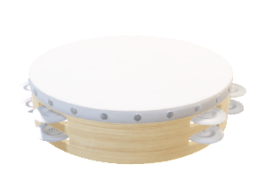
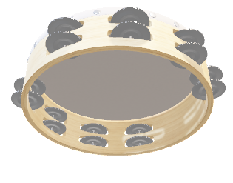
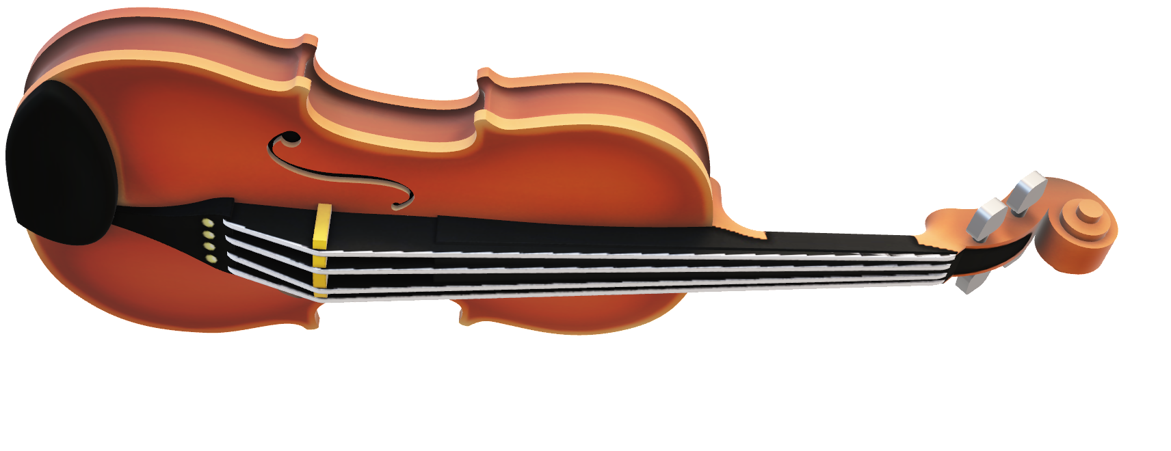
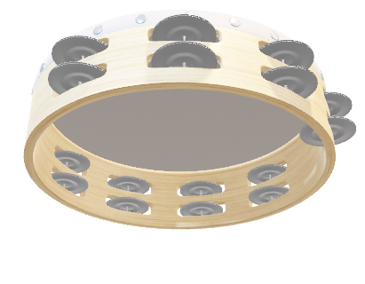
System Architecture
DMZ
Client
Gateway
Server
Intranet
Database
2 Subnets :
192.168.0.0/24 represents the Intranet + DMZ
192.168.1.0/24 represents the outside net
Notes:
Zayneb
2 subnets :
192.168.0.0/24 represents the Intranet + DMZ
192.168.1.0/24 represents the outside net
4 virtual machines:
- Client Machine : serves as the user's interface for interacting with GrooveGalaxy.
- Database in the intranet : Dedicated to data storage and management, the Database Machine utilizes a carefully designed schema with three tables. User details, are stored in the first table. The other two tables manage song information. We used PostregSQL
Server in the DMZ : This server handles requests from clients. It also has access to user accounts and key accesses through the connection to the database
Gateway controles the Traffic : This machine acts as a gateway or router, managing the traffic between the internet and the internal network. It also enforces firewall rules and monitors for unauthorized access.

Slide 4
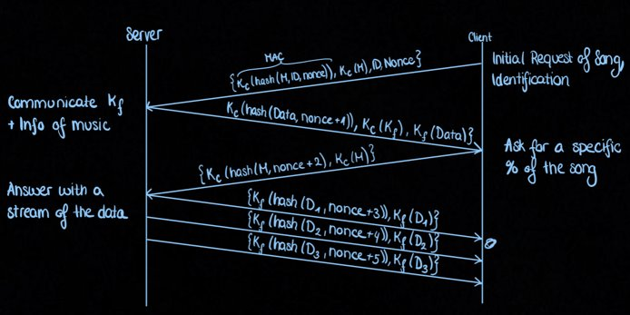
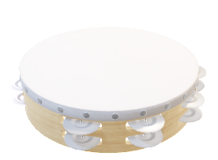
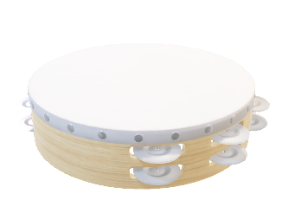
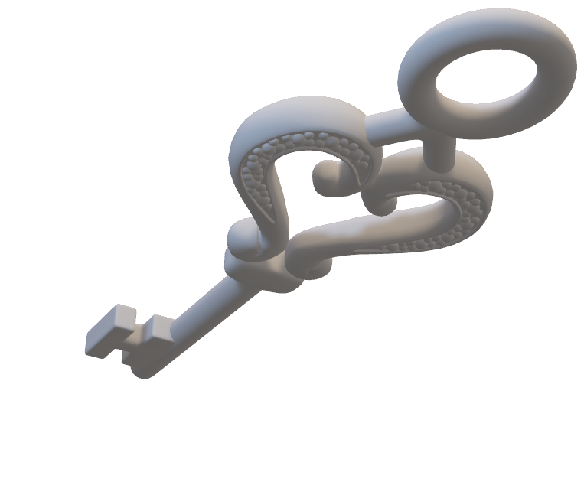
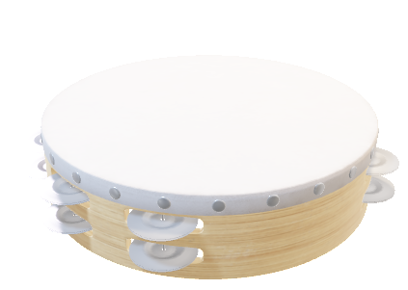
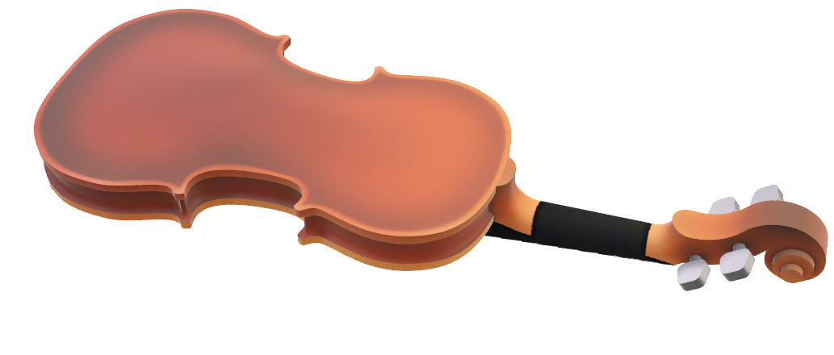
Secure communication
Notes:
Cherie

Slide 5

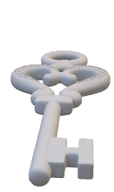


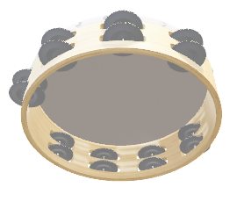

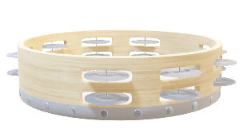

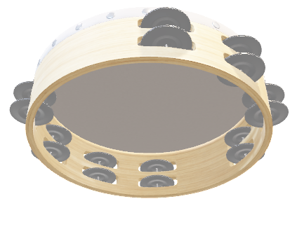

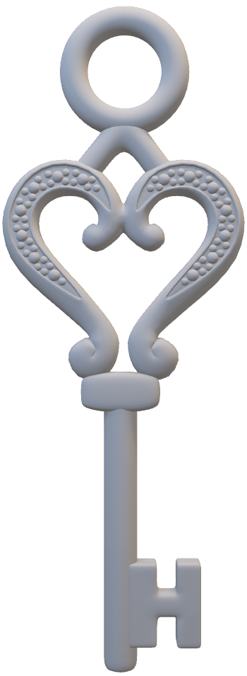
Secure channels and key distribution
In the network layer the communication between server and client use ssl.
In the database we store for each existing client its family key and it own symmetric key.
Each client has his symmetric key shared with the server.
Keys are distributed in advance.
Other security consideration: the firewall rules.
Notes:
Zayneb
Key management begins with the generation of SSL/TLS keys for the server, which are automatically generated by the HTTPS library in Java. This automation simplifies the process of key generation and ensures that the keys are created following best practices for security. During the handshake process, the server's public key certificate, is shared with clients to establish a secure connection.
For the encryption of data, symmetric keys are used. In the database we store for each existing client its family key and it own symmetric key. Each client has his symmetric key shared with the server.
These keys are generated and distributed in advance.
Other security consideration is : the firewall rules: The gateway/router should have strict firewall rules to control incoming and outgoing network traffic, only allowing authorized communications and protecting against network-based attacks.

Slide 6


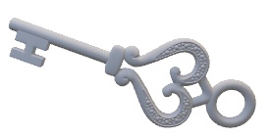
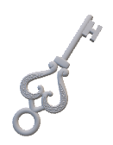

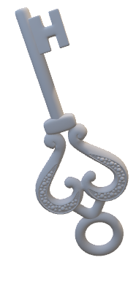

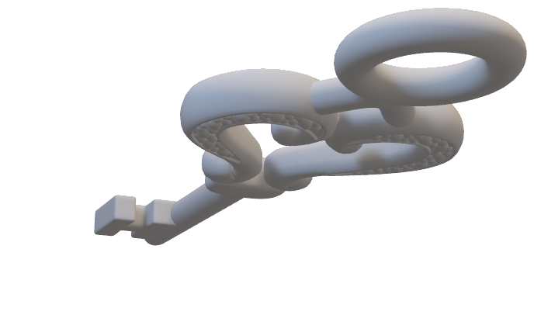

Security challenge
Playback in the middle of the music securely:
Encryption in CTR mode and incremention of nonce until the byte needed
Family sharing :
The transmitted music streamed is encoded with the family key of the user
Notes:
Cherie

Slide 7

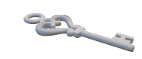

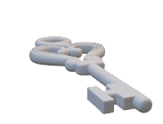

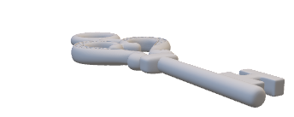
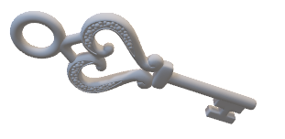
Conclusion
Main accomplishments:
Secure client-server communication through HTTPS.
Efficient audio streaming with AES encryption in CTR mode for quick start playback, and ensuring robust communication using AES in CBC mode.
A graphical user interface (GUI) that enhances the overall user experience.
Possible improvment:
A more sophisticated system for the use of the family key for sharing music.
A better handle of the exception
Be able to login and register new users
Notes:
Rassene

Slide 8
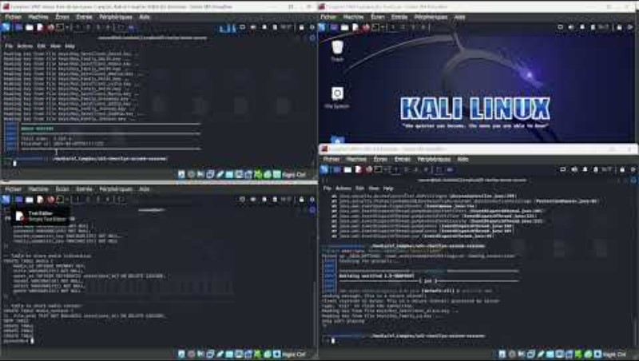

Demo
Notes:
Rassene

